Slide 1
Azure Virtual Network
김태현
010-6548-6258
thkim6258@icloud.com
github.com/thkim6258

Slide 2
Overview
Azure Virtual Network(vNet)
Network Security Groups(NSG)
vNet Peering
Creating Virtual networks
Using Template
Using PowerShell
Using CLI
Configuring Vnet Peering

Slide 3
Azure Virtual Network(vNet)

Slide 4
Azure Virtual Network(vNet)
Azure의 Private 네트워크의 기본 구성 요소
서버에 구성한 다양한 Azure 리소스들끼리 서로 또는 구성한 서버가 인터넷 및 특정 On-Premise 네트워크와 안전하게 통신 가능

Slide 5
Azure Virtual Network(vNet)
물리적으로 연결되어 있는 네트워크를 “논리적, 추상적”으로 나눔
목적에 맞게 네트워크를 나누어 관리하기 수월하게 하기 위함
하나 이상의 Subnet으로 구성되어야 함
CIDR : Classless Inter Domain Routing
10.1.123.9/20 : 네트워크 영역 / 호스트 영역
VLSM : Variable Length Subnet Mask
IP를 효율적으로 할당하기 위해 서로 다른 크기의 서브넷 지원
192.168.30.0/24를 부여받은 회사에 100개 호스트가 필요한 부서 2개

Slide 6
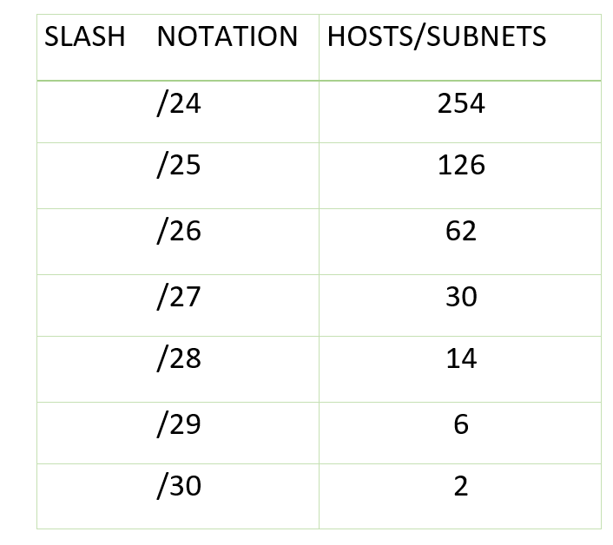
Azure Virtual Network(vNet)
주소 공간을 10.0.0.0/16으로 지정한 Vnet에 VM을 배포하는 경우, VM에는 10.0.0.4부터 Private IP가 할당됩니다.
네트워크 주소 / 브로드캐스트 주소
Azure 예약 주소 3개 : 10.0.0.1, 10.0.0.2, 10.0.0.3

Slide 7
Network Security Groups(NSG)

Slide 8
Network Security Groups(NSG)
가상 네트워크의 방화벽 역할
여러 종류의 Azure 리소스에서 오는 인바운드 트래픽 또는 Azure 리소스로 나가는 아웃바운드 네트워크 트래픽을 허용하거나 거부하는 보안 규칙을 관리하는 도구

Slide 9
vNet Peering

Slide 10
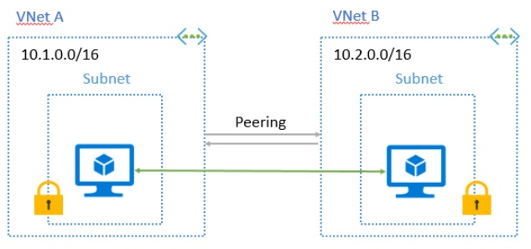
vNet Peering
같은 Azure Data Center 내 vNet 간의 연결하기 위해 사용
vNet-to-vNet : 다른 Data Center의 vNet 간의 연결을 하기 위해
명시적으로 연결한 vNet끼리만 통신 가능

Slide 11
Creating Virtual networks USING Template

Slide 12
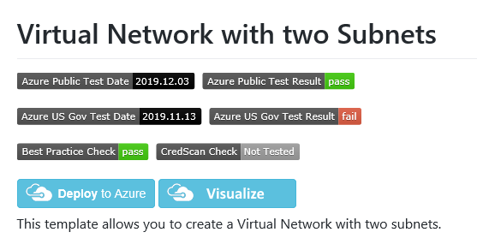
Creating Virtual networks USING Template
https://github.com/Azure/azure-quickstart-templates/tree/master/101-vnet-two-subnets

Slide 13
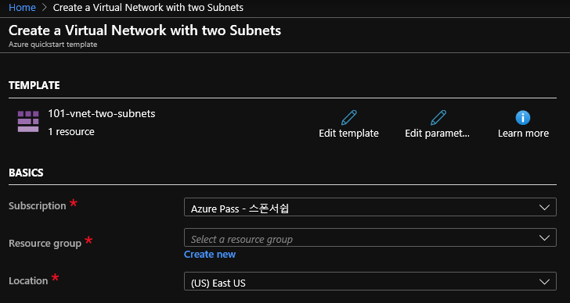
Creating Virtual networks USING Template

Slide 14
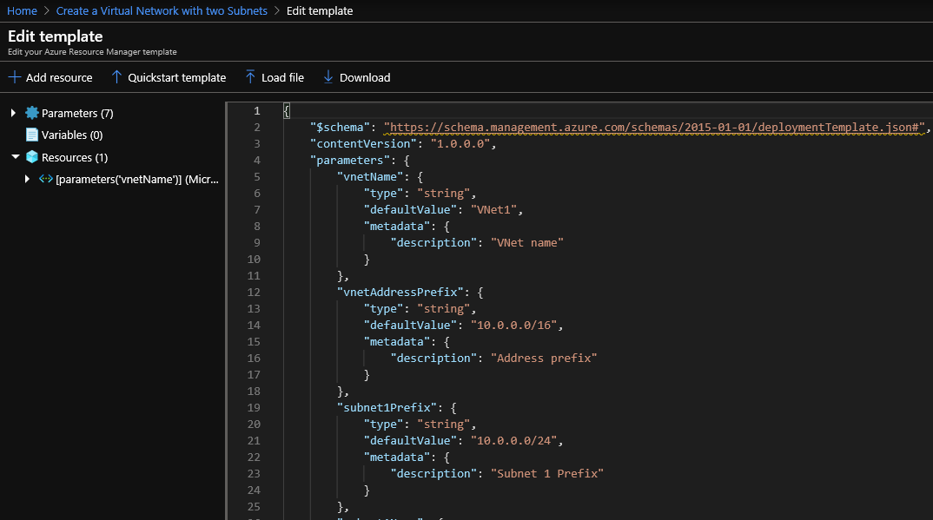
Creating Virtual networks USING Template

Slide 15
Creating Virtual networks USING Template

Slide 16
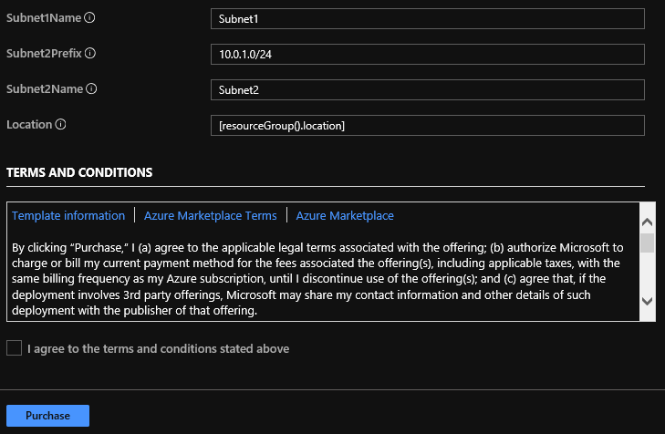
Creating Virtual networks USING Template

Slide 17
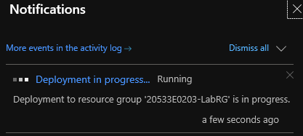
Creating Virtual networks USING Template

Slide 18
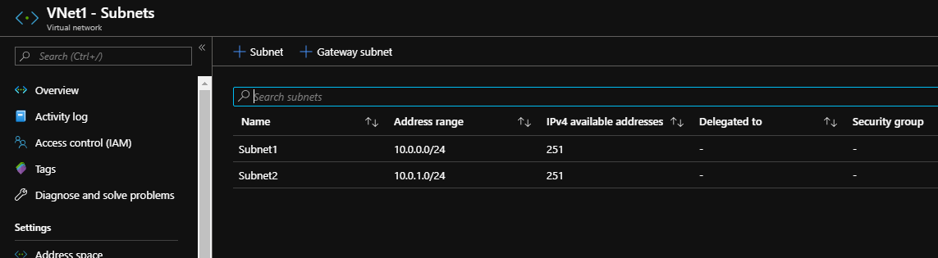
Creating Virtual networks USING Template

Slide 19
Creating Virtual networks USING PowerShell

Slide 20
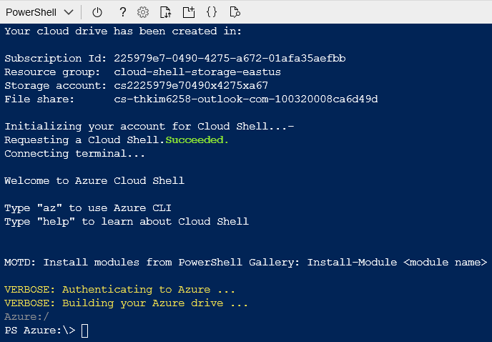
Creating Virtual networks USING PowerShell

Slide 21
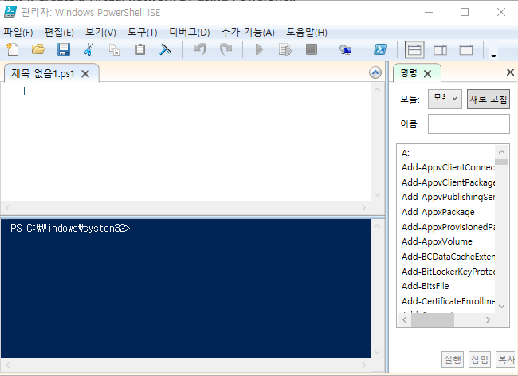
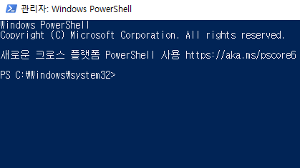
Creating Virtual networks USING PowerShell

Slide 22
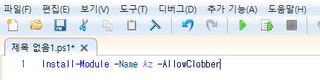
Creating Virtual networks USING PowerShell

Slide 23
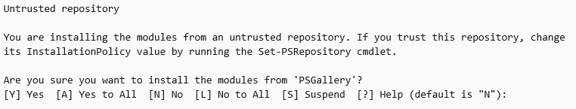
Creating Virtual networks USING PowerShell

Slide 24
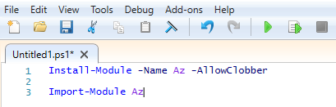
Creating Virtual networks USING PowerShell

Slide 25
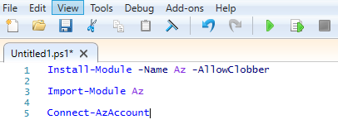
Creating Virtual networks USING PowerShell

Slide 26
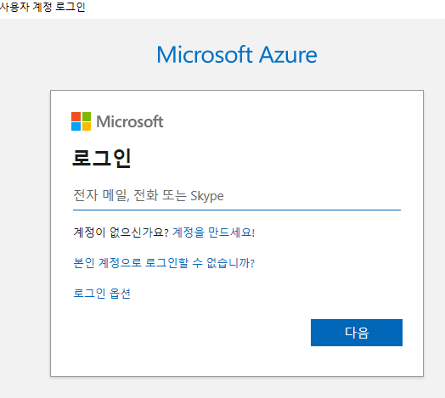
Creating Virtual networks USING PowerShell

Slide 27
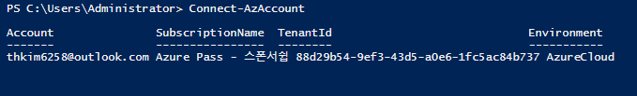
Creating Virtual networks USING PowerShell

Slide 28
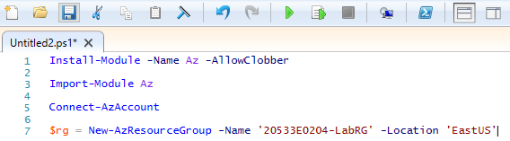
Creating Virtual networks USING PowerShell

Slide 29
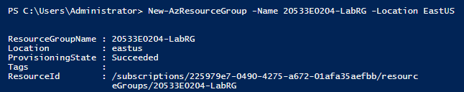
Creating Virtual networks USING PowerShell

Slide 30
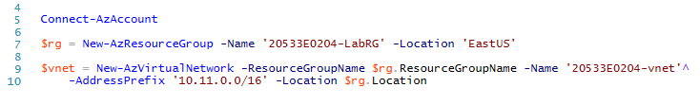
Creating Virtual networks USING PowerShell

Slide 31
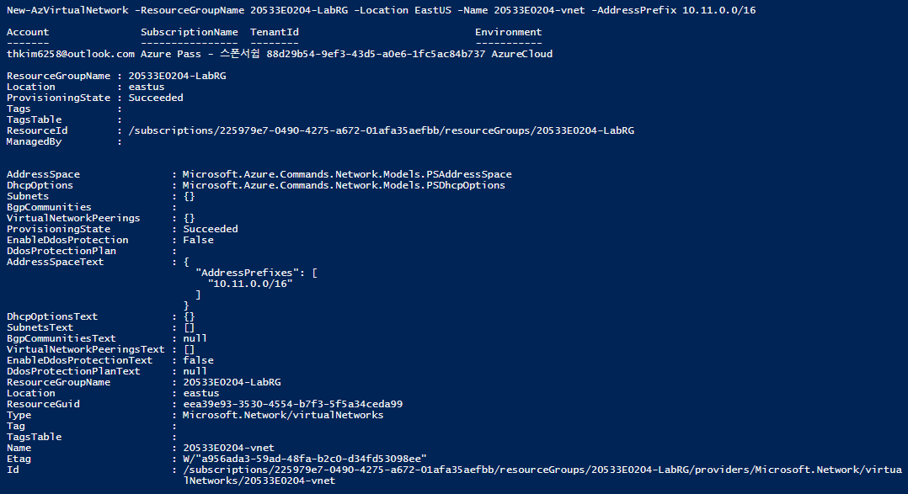
Creating Virtual networks USING PowerShell

Slide 32
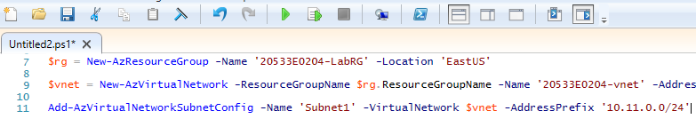
Creating Virtual networks USING PowerShell

Slide 33
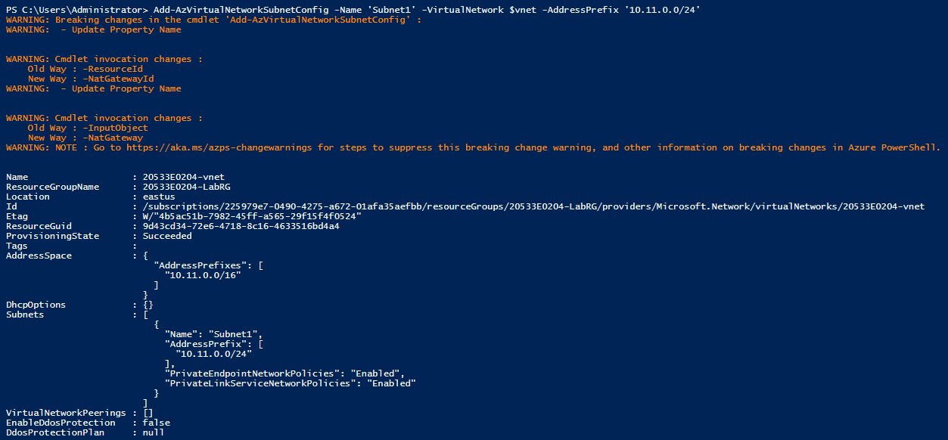
Creating Virtual networks USING PowerShell

Slide 34
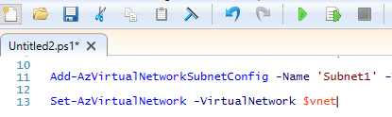
Creating Virtual networks USING PowerShell

Slide 35
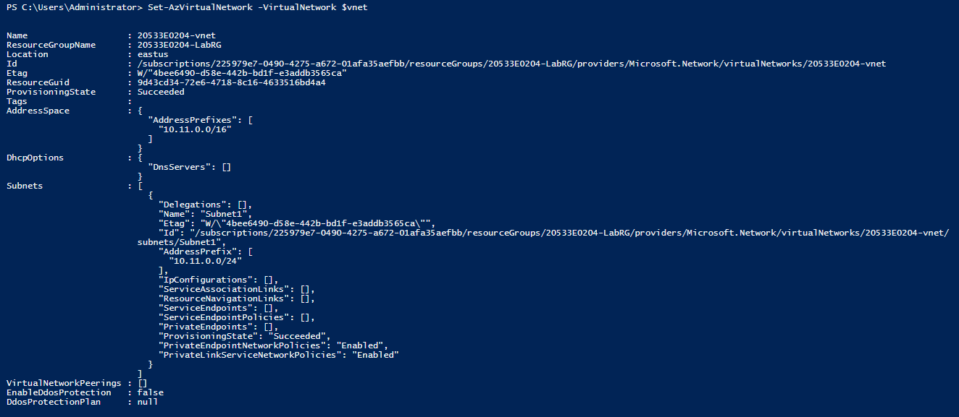
Creating Virtual networks USING PowerShell

Slide 36
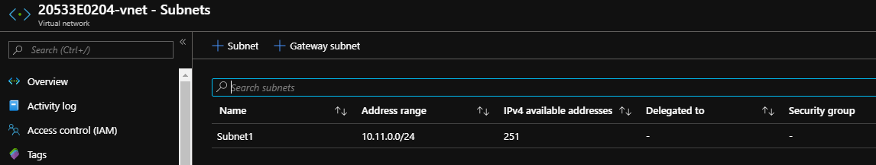
Creating Virtual networks USING PowerShell

Slide 37
Creating Virtual networks USING ClI

Slide 38
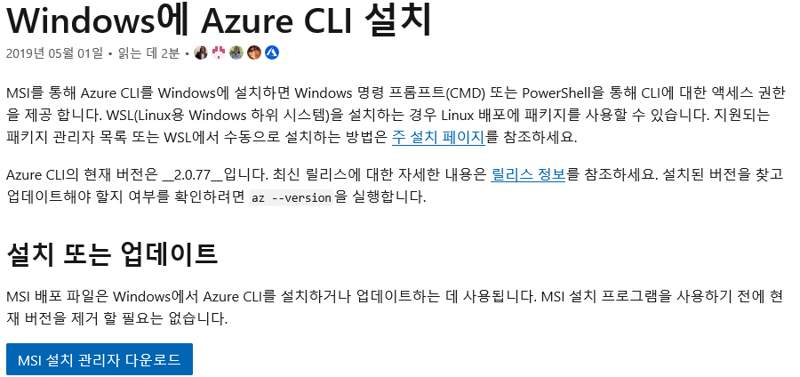
Creating Virtual networks USING ClI
https://docs.microsoft.com/ko-kr/cli/azure/install-azure-cli-windows?view=azure-cli-latest

Slide 39
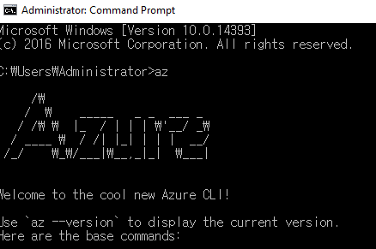
Creating Virtual networks USING ClI

Slide 40
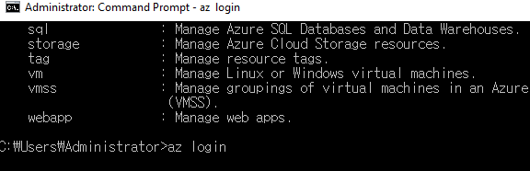
Creating Virtual networks USING ClI

Slide 41
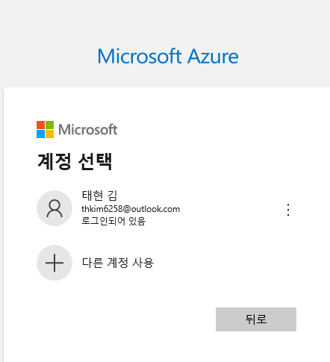
Creating Virtual networks USING ClI

Slide 42
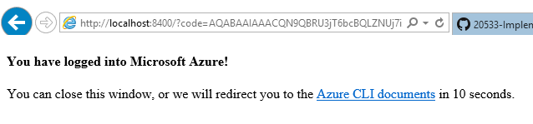
Creating Virtual networks USING ClI

Slide 43
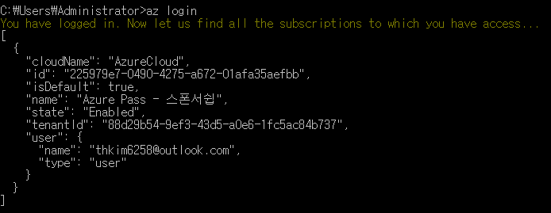
Creating Virtual networks USING ClI

Slide 44
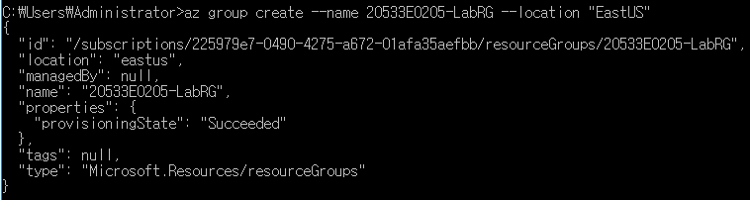
Creating Virtual networks USING ClI

Slide 45
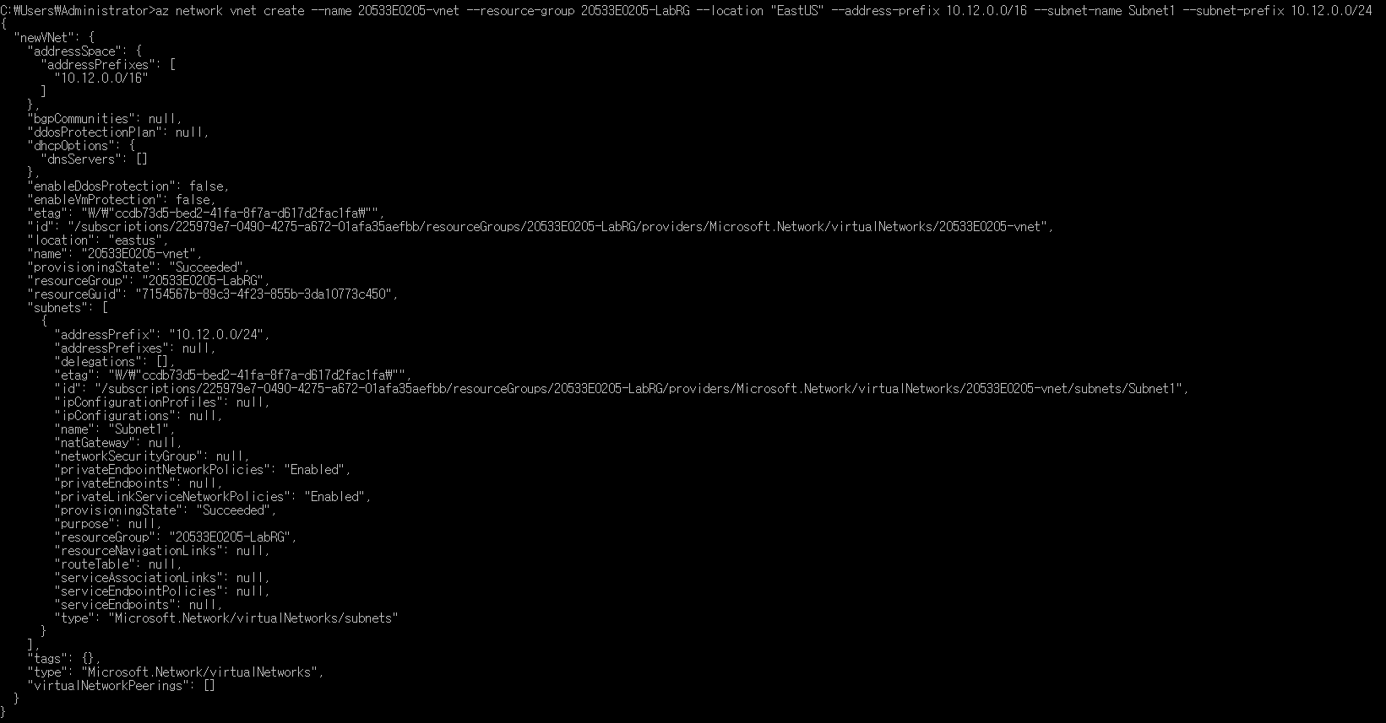
Creating Virtual networks USING ClI

Slide 46
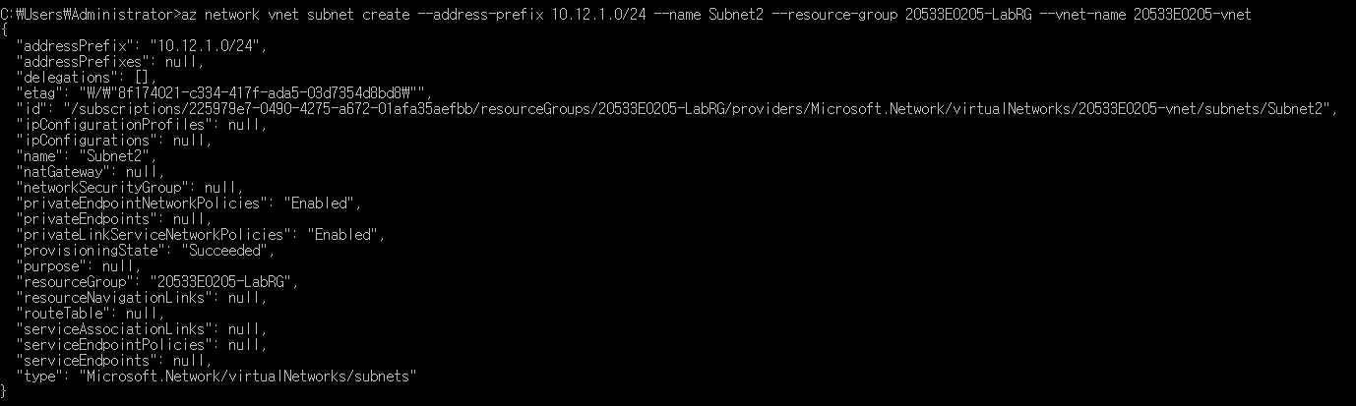
Creating Virtual networks USING ClI

Slide 47
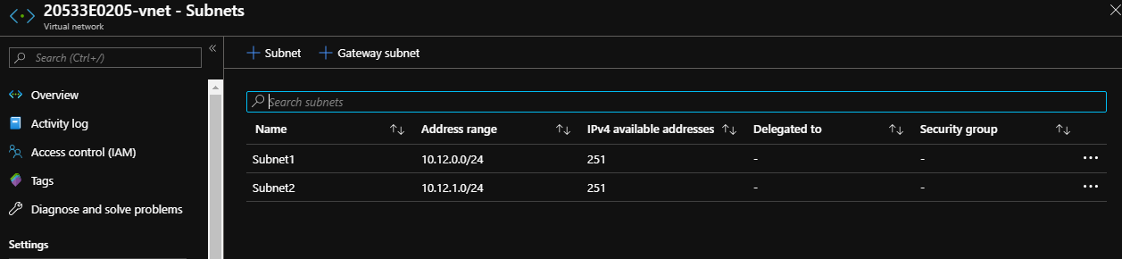
Creating Virtual networks USING ClI

Slide 48
Configuring Vnet Peering

Slide 49
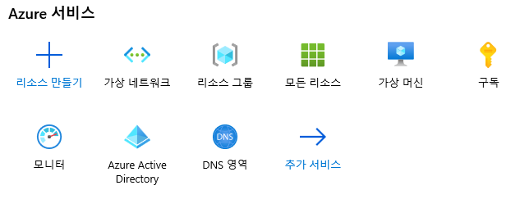
Configuring Vnet Peering

Slide 50
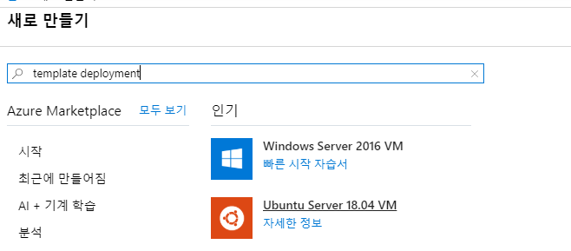
Configuring Vnet Peering

Slide 51
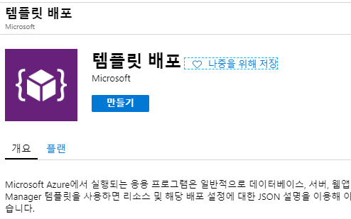
Configuring Vnet Peering

Slide 52
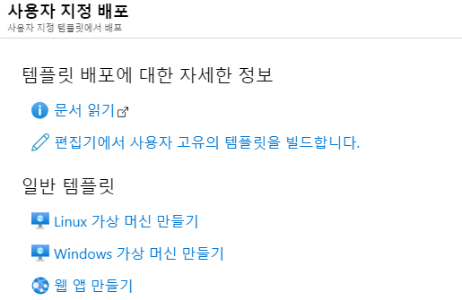
Configuring Vnet Peering

Slide 53
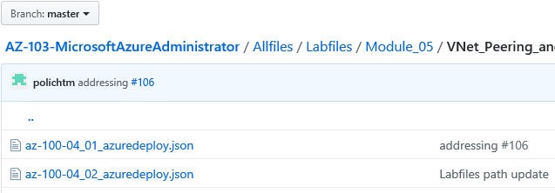
Configuring Vnet Peering
https://github.com/MicrosoftLearning/AZ-103-MicrosoftAzureAdministrator/tree/master/Allfiles/Labfiles/Module_05/VNet_Peering_and_Service_Chaining

Slide 54
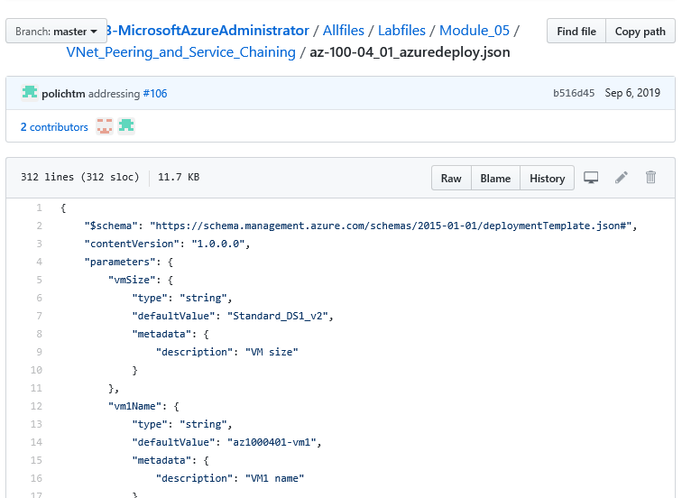
Configuring Vnet Peering

Slide 55
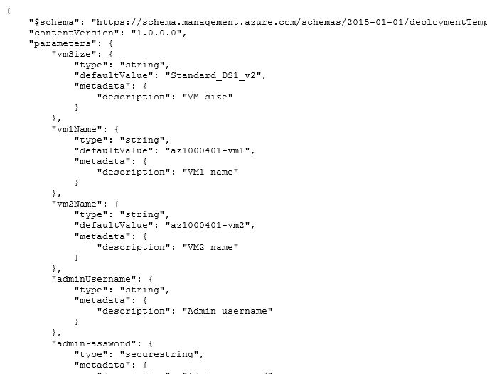
Configuring Vnet Peering

Slide 56
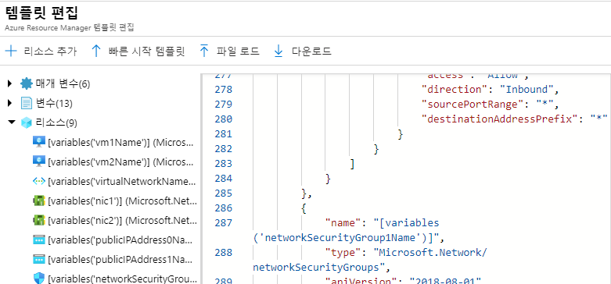
Configuring Vnet Peering

Slide 57
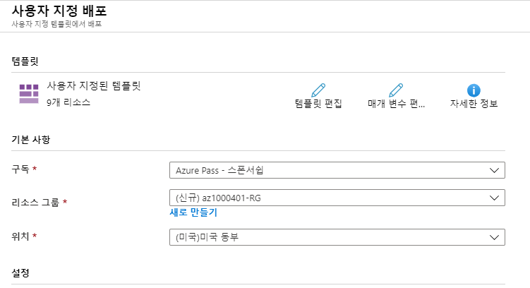
Configuring Vnet Peering

Slide 58
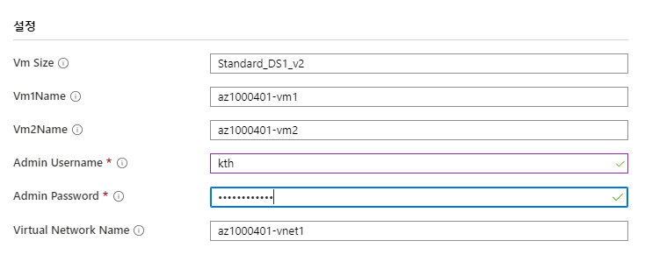
Configuring Vnet Peering

Slide 59
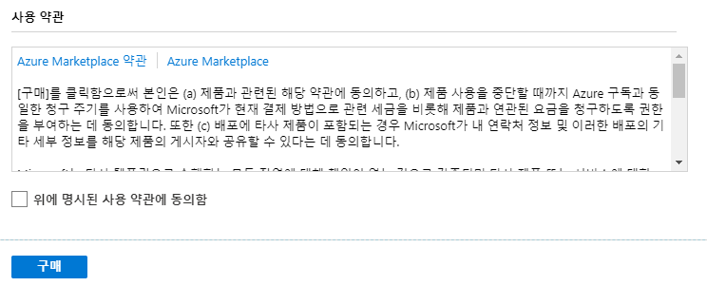
Configuring Vnet Peering

Slide 60
Configuring Vnet Peering

Slide 61
Configuring Vnet Peering

Slide 62
Configuring Vnet Peering

Slide 63
Configuring Vnet Peering

Slide 64
Configuring Vnet Peering
https://github.com/MicrosoftLearning/AZ-103-MicrosoftAzureAdministrator/tree/master/Allfiles/Labfiles/Module_05/VNet_Peering_and_Service_Chaining

Slide 65
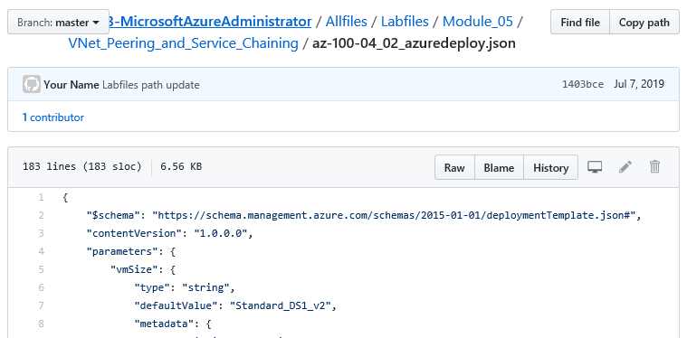
Configuring Vnet Peering

Slide 66
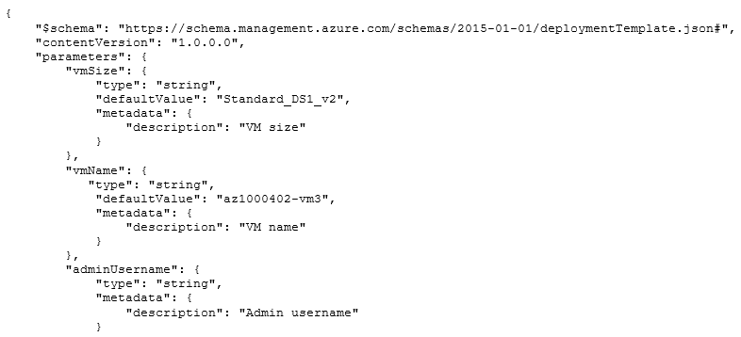
Configuring Vnet Peering

Slide 67
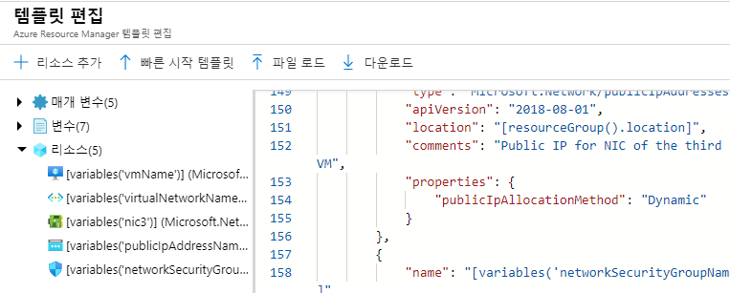
Configuring Vnet Peering

Slide 68

Configuring Vnet Peering

Slide 69

Configuring Vnet Peering

Slide 70

Configuring Vnet Peering

Slide 71

Configuring Vnet Peering

Slide 72

Configuring Vnet Peering

Slide 73

Configuring Vnet Peering

Slide 74

Configuring Vnet Peering

Slide 75

Configuring Vnet Peering

Slide 76

Configuring Vnet Peering

Slide 77

Configuring Vnet Peering

Slide 78
Configuring Vnet Peering

Slide 79

Configuring Vnet Peering

Slide 80

Configuring Vnet Peering

Slide 81

Configuring Vnet Peering

Slide 82

Configuring Vnet Peering

Slide 83

Configuring Vnet Peering

Slide 84
Configuring Vnet Peering

Slide 85

Configuring Vnet Peering

Slide 86

Configuring Vnet Peering
v
v

Slide 87

Configuring Vnet Peering

Slide 88

Configuring Vnet Peering

Slide 89

Configuring Vnet Peering

Slide 90

Configuring Vnet Peering

Slide 91

Configuring Vnet Peering

Slide 92

Configuring Vnet Peering

Slide 93

Configuring Vnet Peering

Slide 94

Configuring Vnet Peering

Slide 95

Configuring Vnet Peering

Slide 96
Configuring Vnet Peering

Slide 97
Configuring Vnet Peering

Slide 98

Configuring Vnet Peering

Slide 99

Configuring Vnet Peering

Slide 100

Configuring Vnet Peering

Slide 101

Configuring Vnet Peering

Slide 102

Configuring Vnet Peering

Slide 103

Configuring Vnet Peering

Slide 104

Configuring Vnet Peering

Slide 105

Configuring Vnet Peering

Slide 106

Configuring Vnet Peering

Slide 107

Configuring Vnet Peering

Slide 108

Configuring Vnet Peering

Slide 109

Configuring Vnet Peering

Slide 110

Configuring Vnet Peering

Slide 111

Configuring Vnet Peering

Slide 112

Configuring Vnet Peering

Slide 113

Configuring Vnet Peering

Slide 114

Configuring Vnet Peering

Slide 115

Configuring Vnet Peering

Slide 116

Configuring Vnet Peering

Slide 117

Configuring Vnet Peering

Slide 118

Configuring Vnet Peering

Slide 119

Configuring Vnet Peering

Slide 120
References
https://docs.microsoft.com/ko-kr/azure/virtual-network/virtual-networks-overview
http://www.jidum.com/jidums/view.do?jidumId=437
https://www.slideshare.net/ssuserc17528/2017-azure-iaas
https://github.com/kite01/10979-Introduction-to-Azure-for-IT-Professionals/blob/master/Instructions/10979F_LAB_AK_05.md
https://github.com/kite01/20533-ImplementingMicrosoftAzureInfrastructureSolutions/blob/master/Instructions/20533E_LAB_AK_02.md
https://zigispace.net/998
https://github.com/MicrosoftLearning/AZ-103-MicrosoftAzureAdministrator/blob/master/Instructions/Labs/05%20-%20VNet%20Peering%20and%20Service%20Chaining%20(az-100-04).md

Slide 121


